Slide 1
Market Place-Trading project
Story board – jawad kabalan(11930365) & Hussein Jaber(11930366)

Slide 2
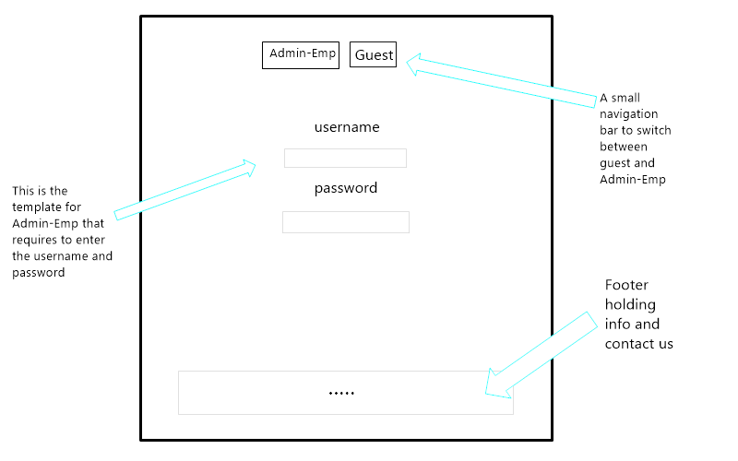
Guest and employee page

Slide 3
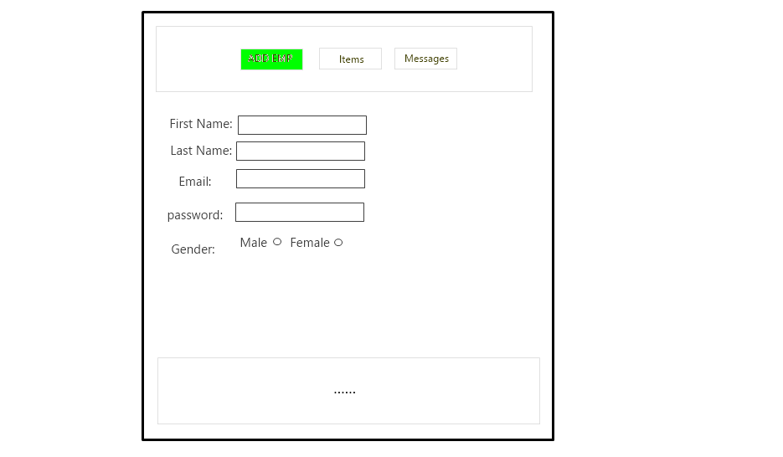
ADMIN Page – ADD EMPLOYEE

Slide 4
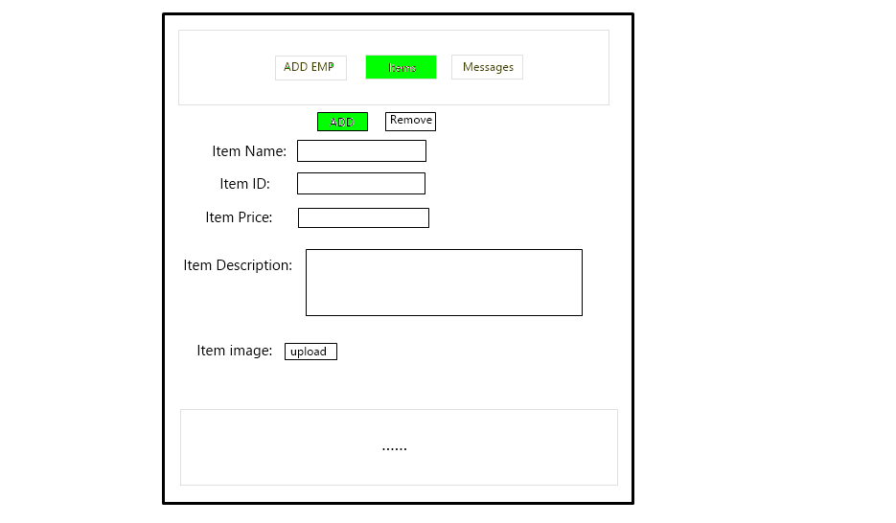
ADMIN PAGE- ITEM MANAGIng

Slide 5
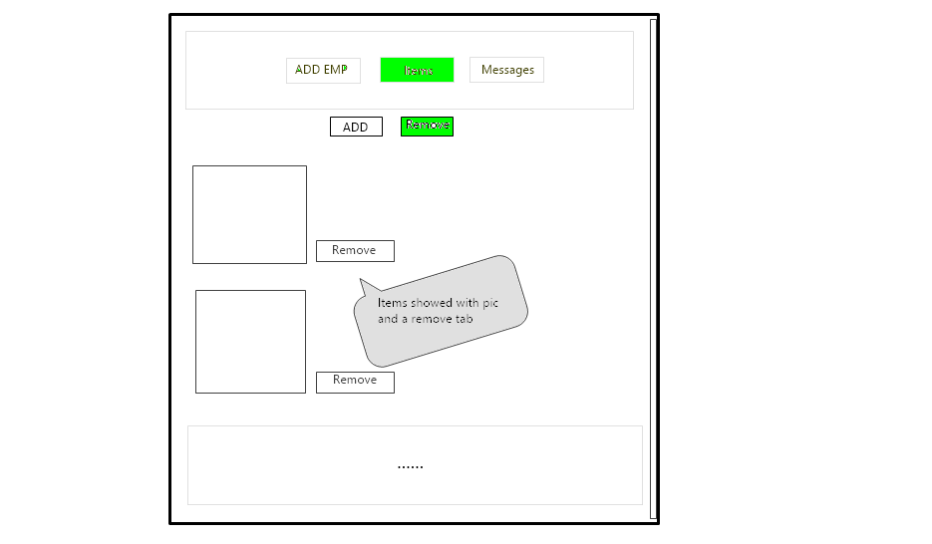
ADMIN PAGE- ITEM Managing

Slide 6
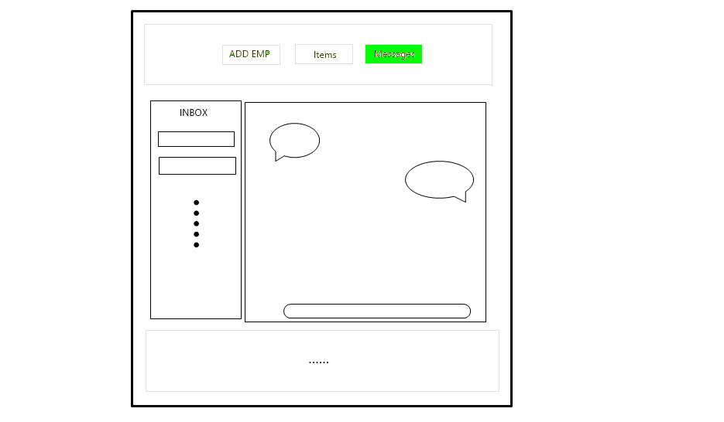
ADMIN PAGE – USERs contacting page

Slide 7
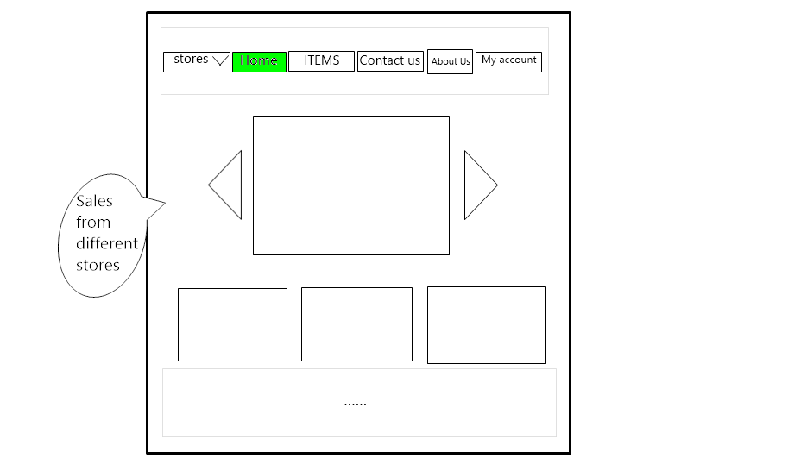
User page – Home Page

Slide 8
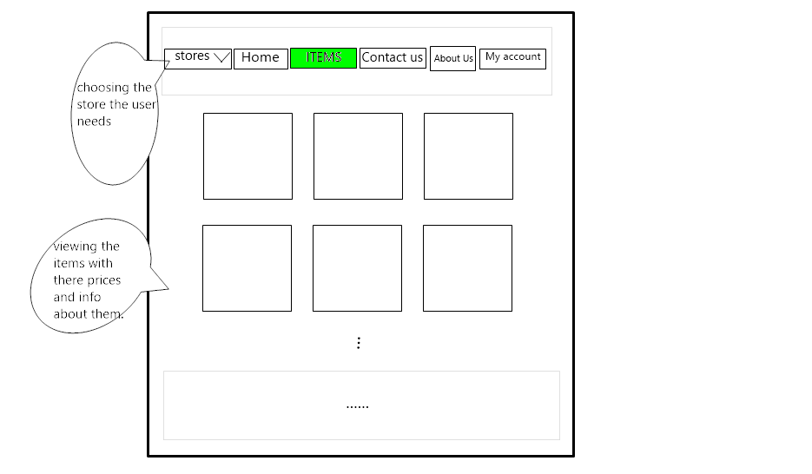
USER PAGE- ITEM VIEWING

Slide 9
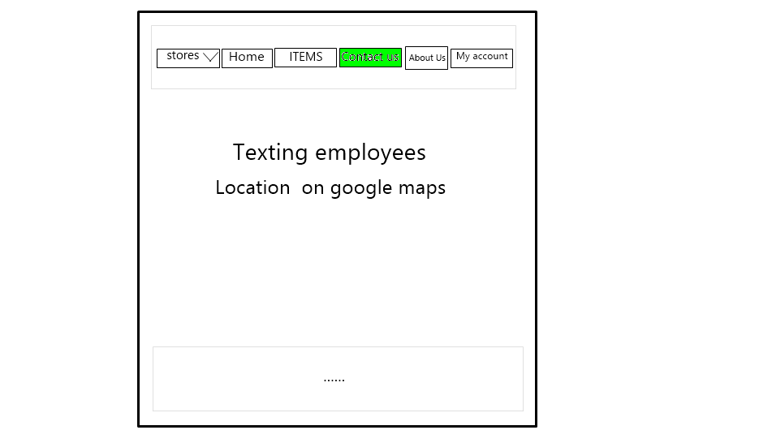
USER PAGE – CONTACT us page

Slide 10
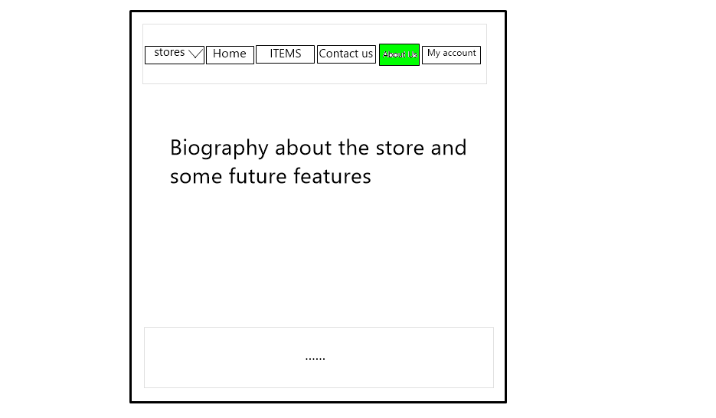
User page – about us section

Slide 11
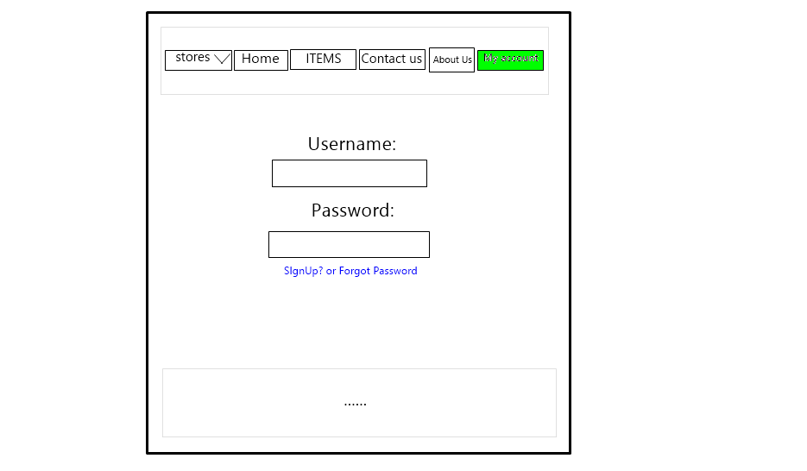
USER PAGE –Login page

Slide 12
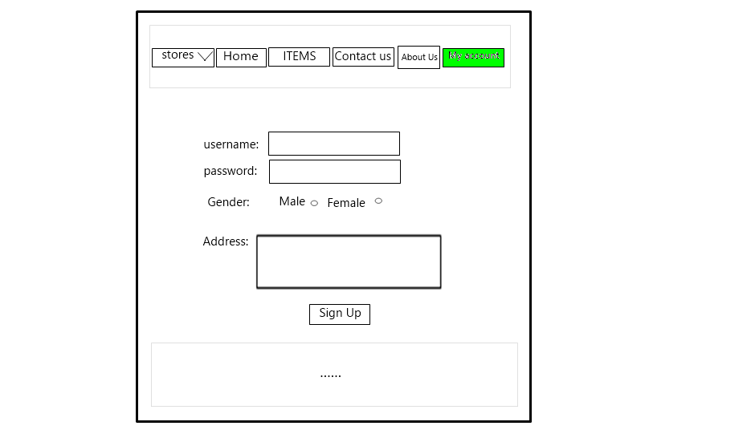
USER Page – signup page

Slide 13
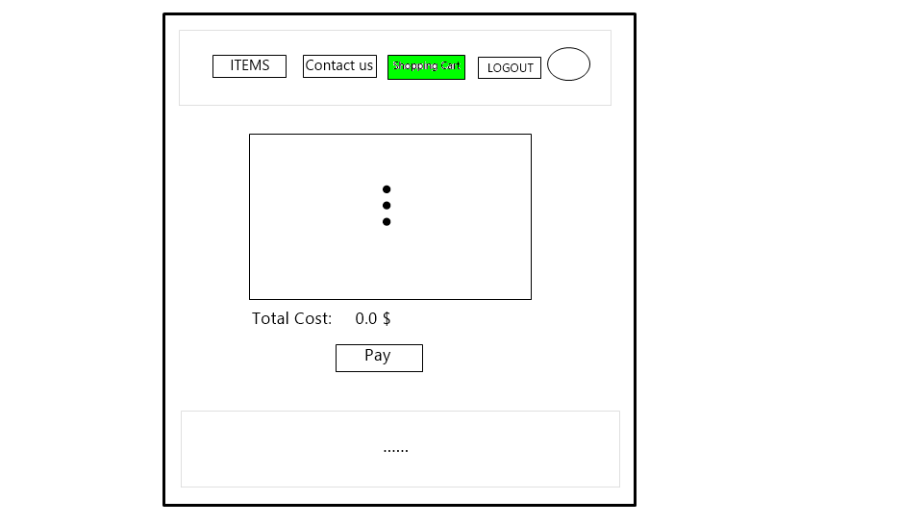
User page – shopping cart

Slide 14
Thank you for watching

